Slide 1
Introduction to WEKA

Slide 2
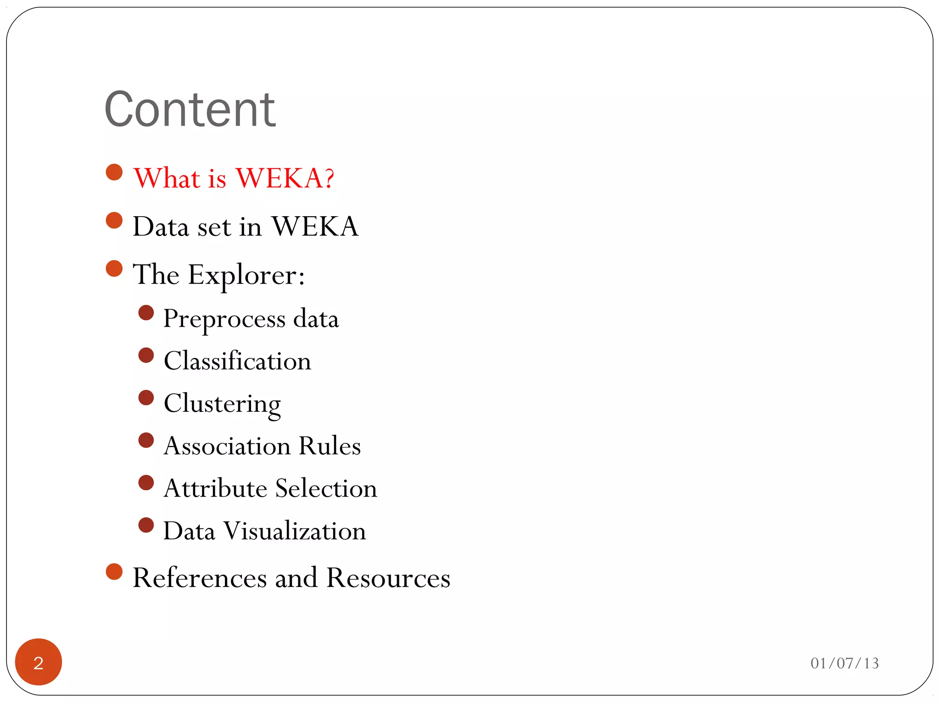

Slide 3
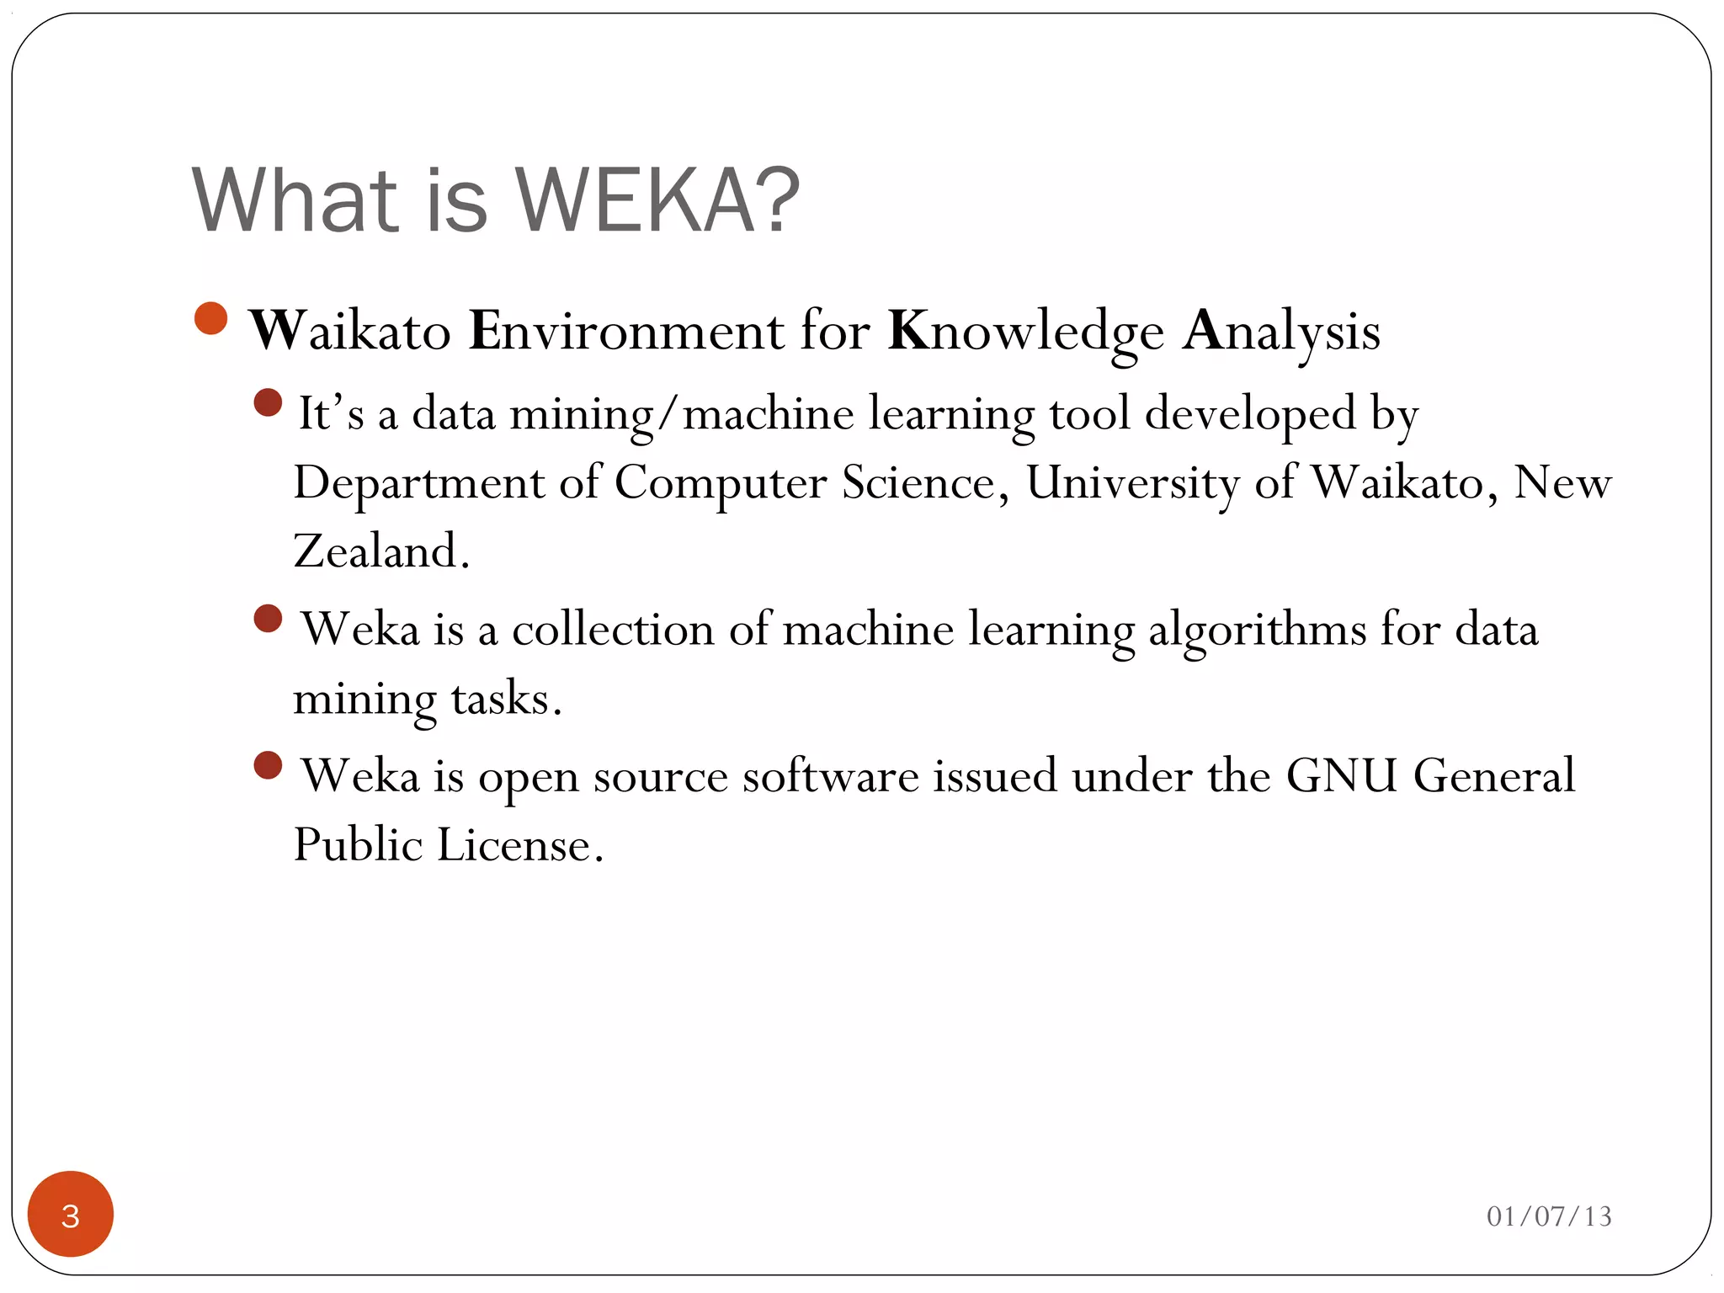

Slide 4
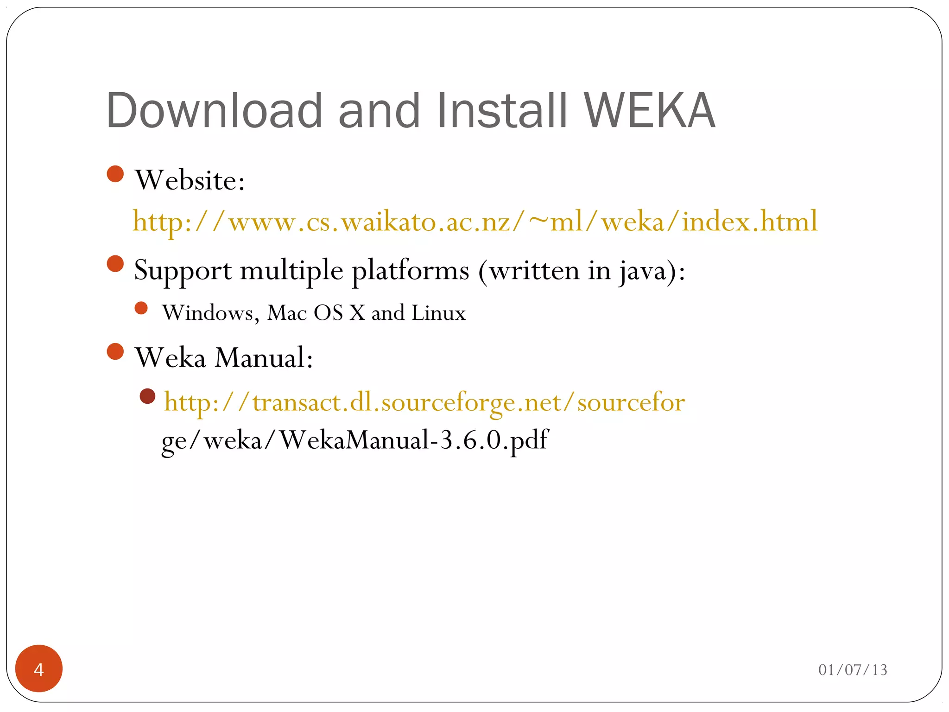

Slide 5
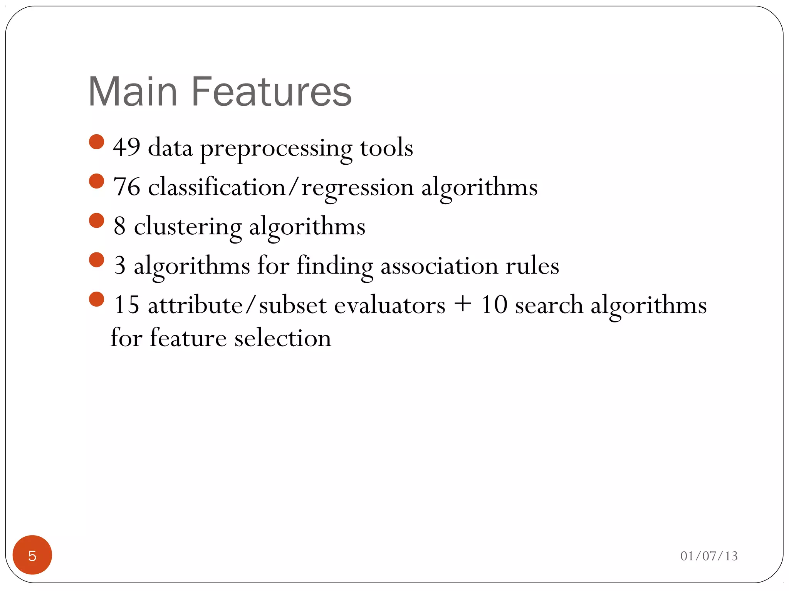

Slide 6
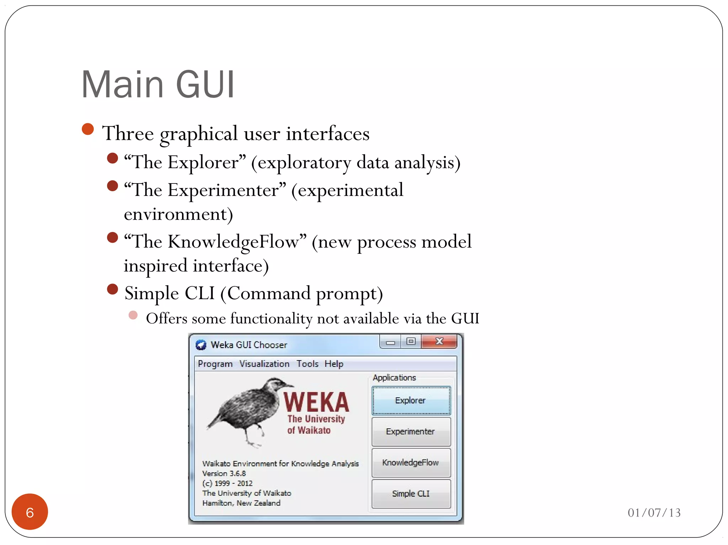

Slide 7
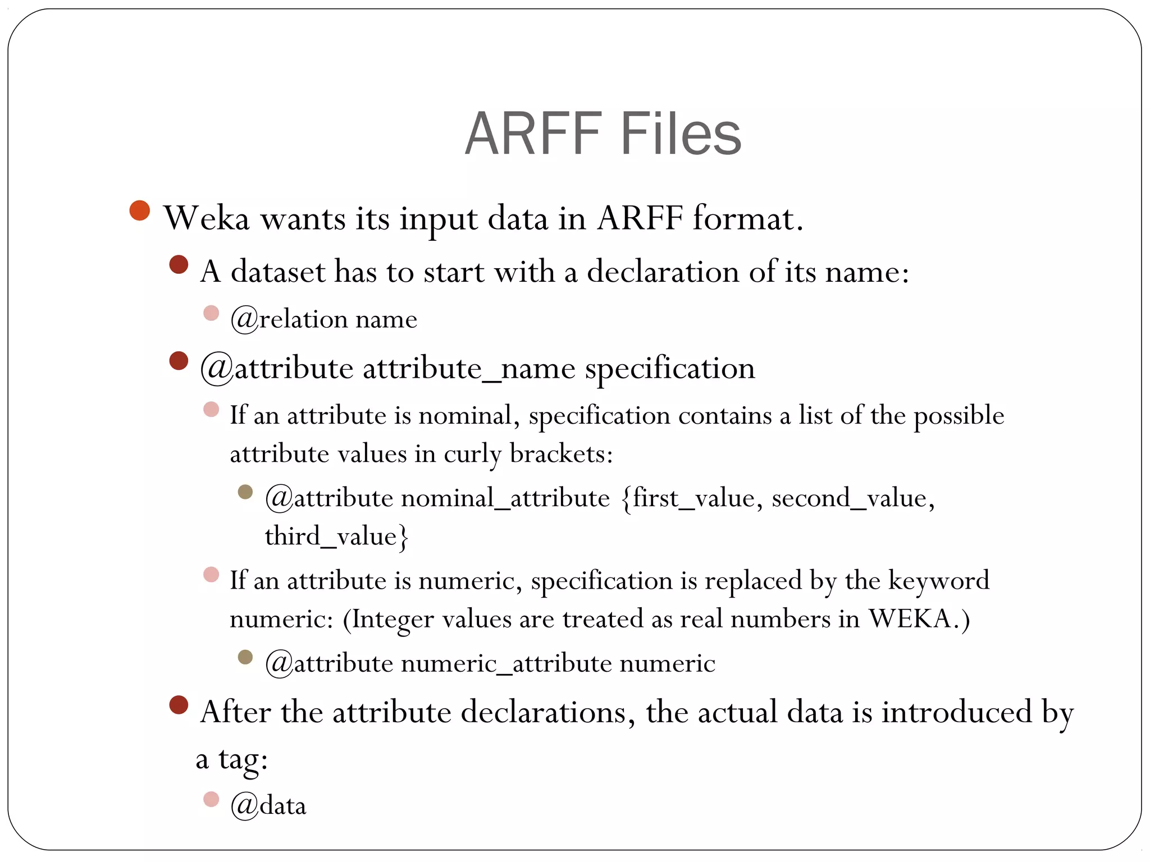

Slide 8
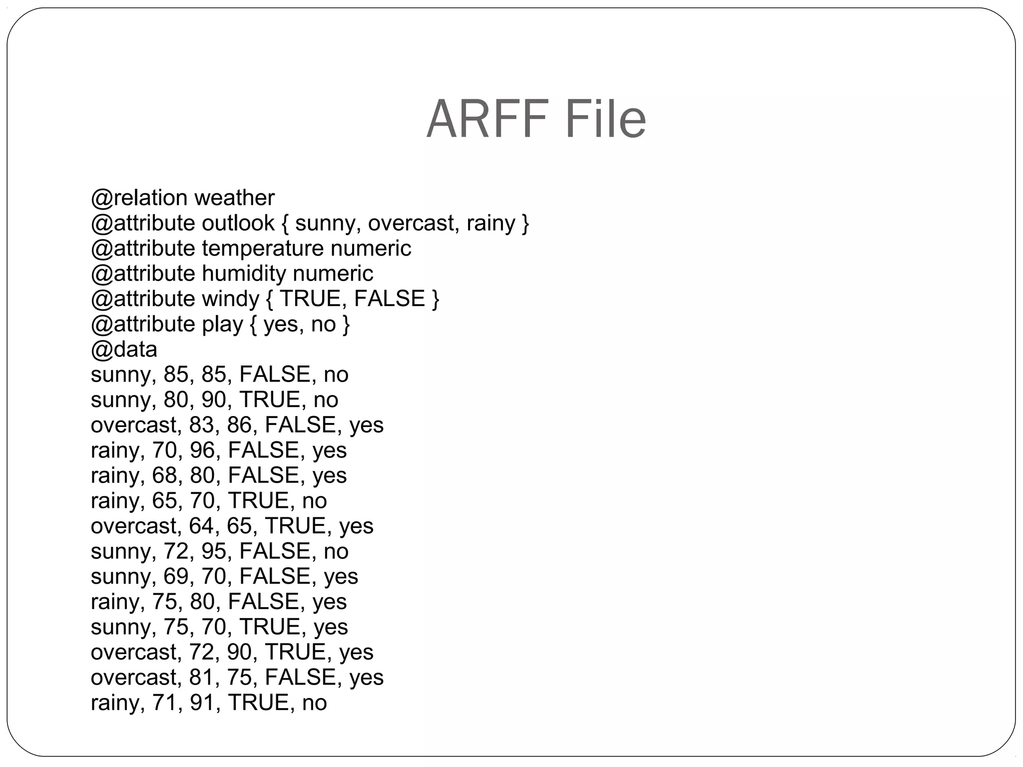

Slide 9
Weka ARFF Example
@relation heart-disease-simplified
@attribute age numeric
@attribute sex { female, male}
@attribute chest_pain_type { typ_angina, asympt, non_anginal, atyp_angina}
@attribute cholesterol numeric
@attribute exercise_induced_angina { no, yes}
@attribute class { present, not_present}
@data
63,male,typ_angina,233,no,not_present
67,male,asympt,286,yes,present
67,male,asympt,229,yes,present
38,female,non_anginal,?,no,not_present
...
This just defines dataset name
Categorical feature must list values

Slide 10
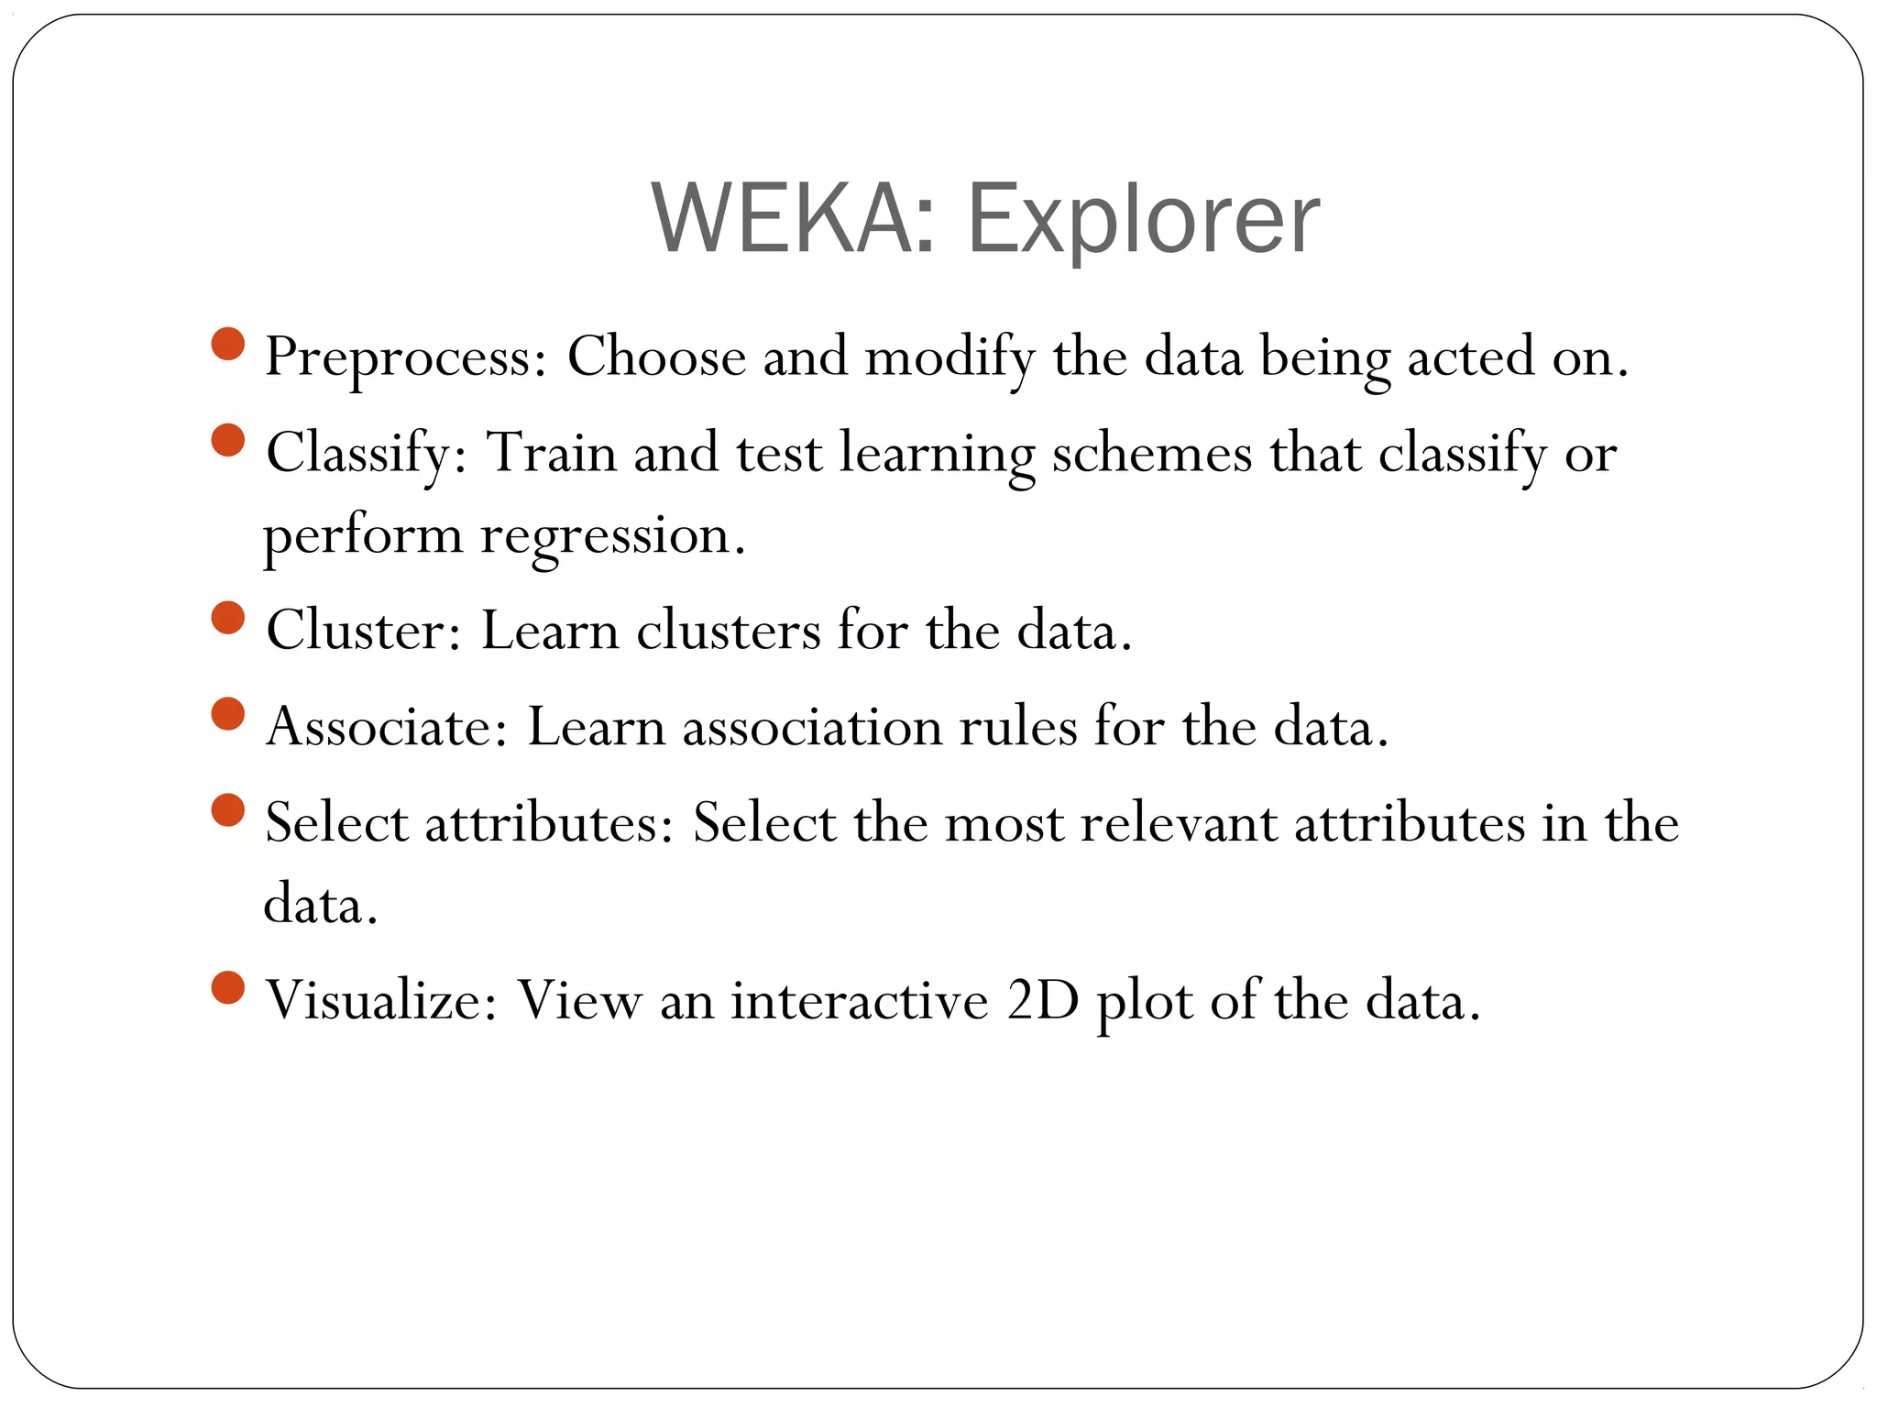

Slide 11
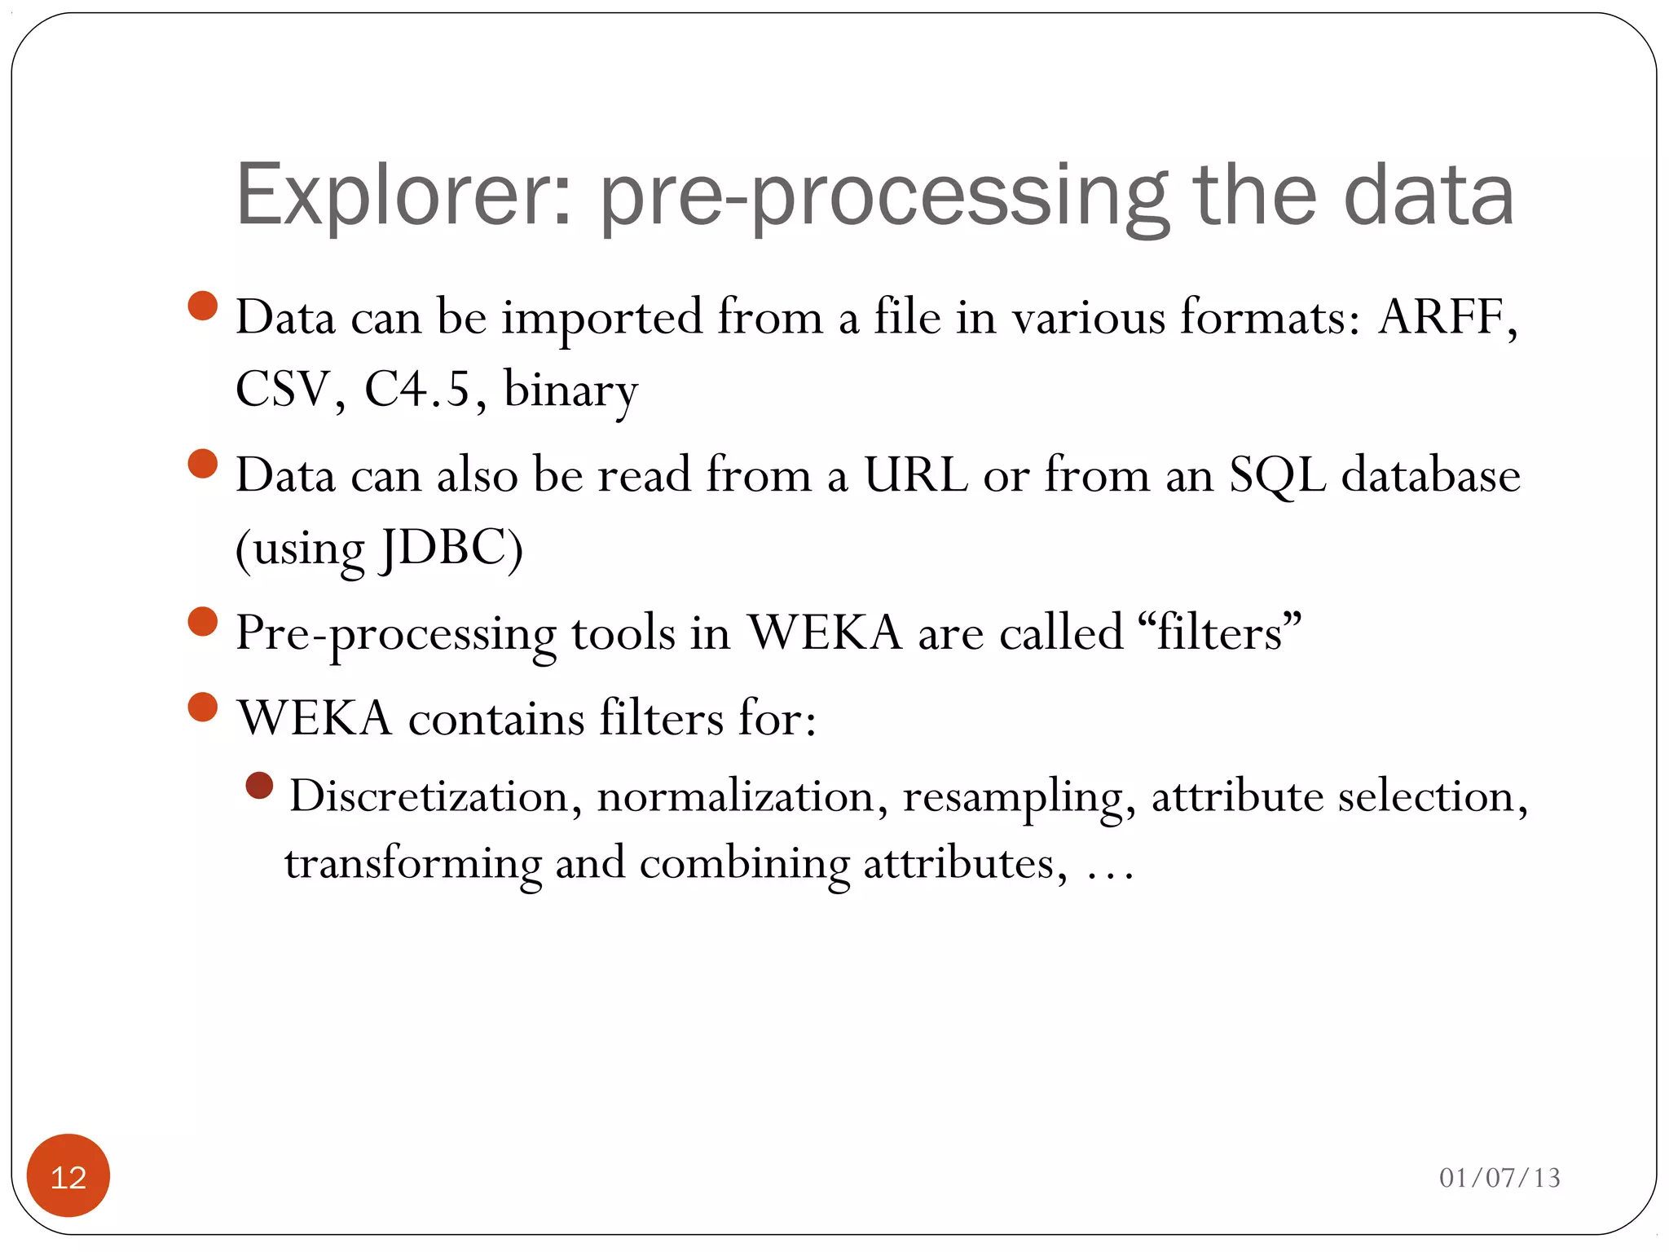

Slide 12
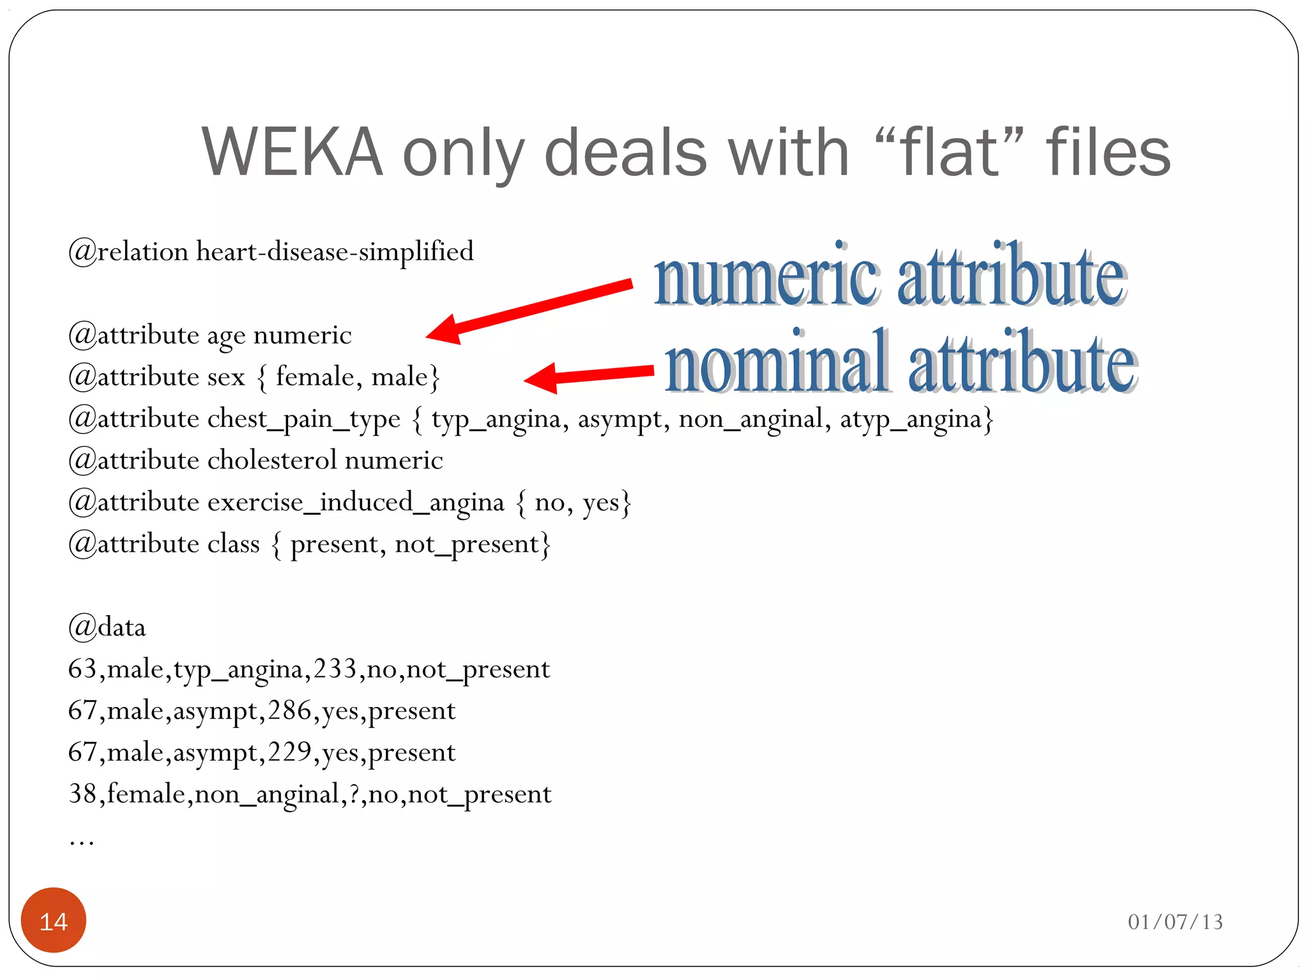

Slide 13
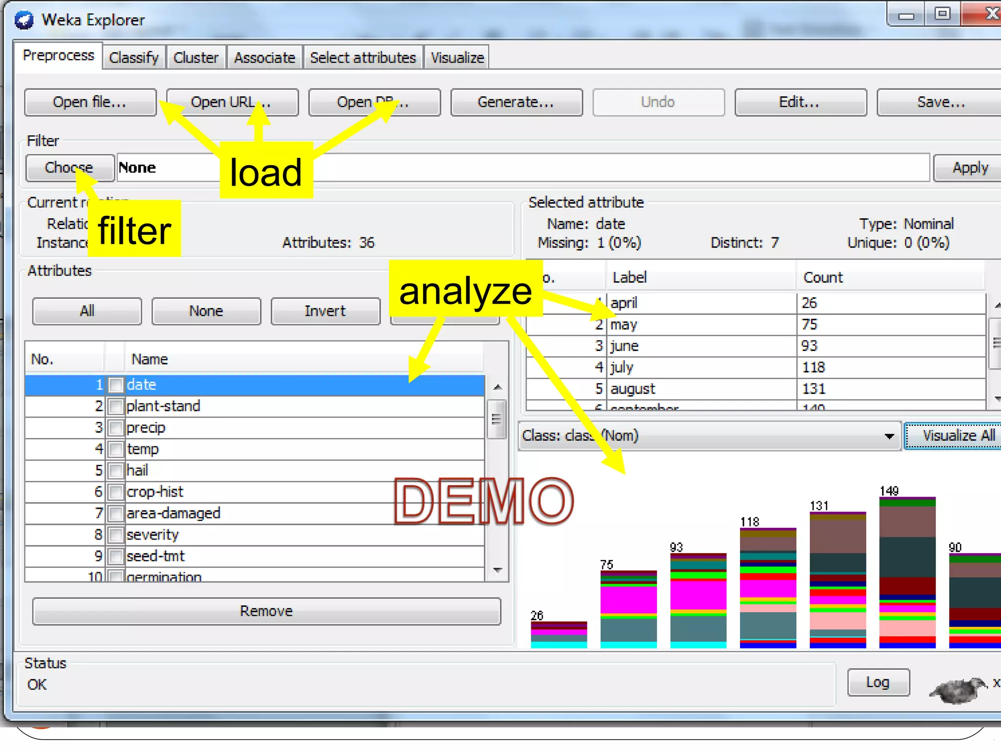

Slide 14
Reading in the Iris Dataset
We start with the well-known Iris data set
Weka probably installed it so search for “iris”.
Otherwise download it from my copy on internet:
https://storm.cis.fordham.edu/~gweiss/data-mining/weka-data/iris.arff
Open it using “Open File” or “Open URL”
Weka immediately shows stats about the features and how they are distributed
Other data sets it you want to play around:
https://storm.cis.fordham.edu/~gweiss/data-mining/datasets.html
Hundreds of others available from UCI Machine Learning Repository
https://archive.ics.uci.edu/ml/

Slide 15
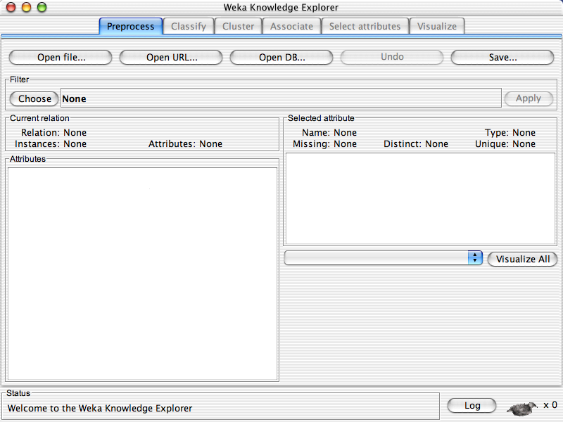

Slide 16
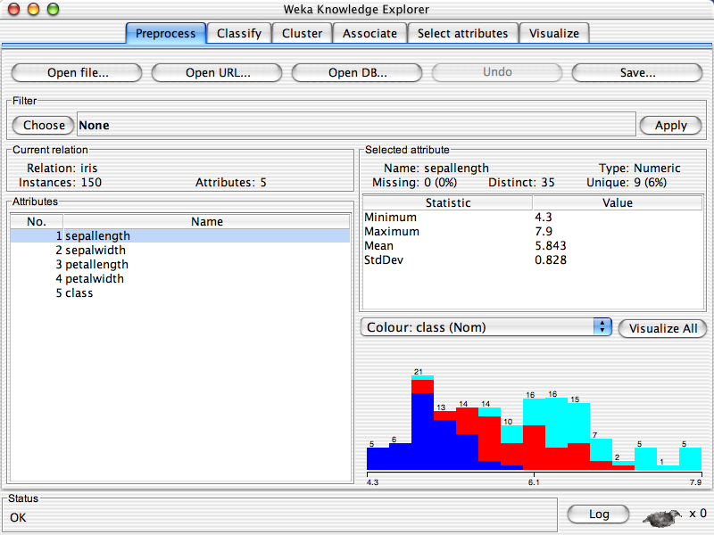
Distribution of sepallength with colors representing 3 class values

Slide 17
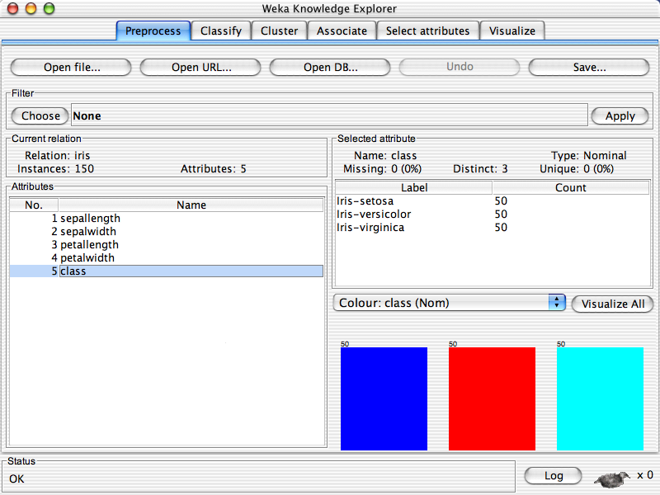
Distribution of the 3 classes, which are evenly distribute

Slide 19
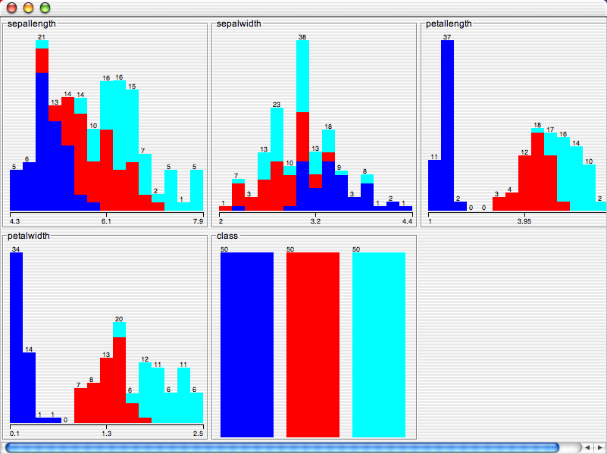
Visualization of all feature values with class information. This makes it clear that most features are useful for distinguishing classes.

Slide 20
Preprocessing Filters
Pre-processing tools in WEKA called “filters”
Many preprocessing filters available:
Discretization
Normalization
Resampling
Feature selection
Feature transformation
Many more
Know what available so can use it when needed
We will focus on Discretization

Slide 21
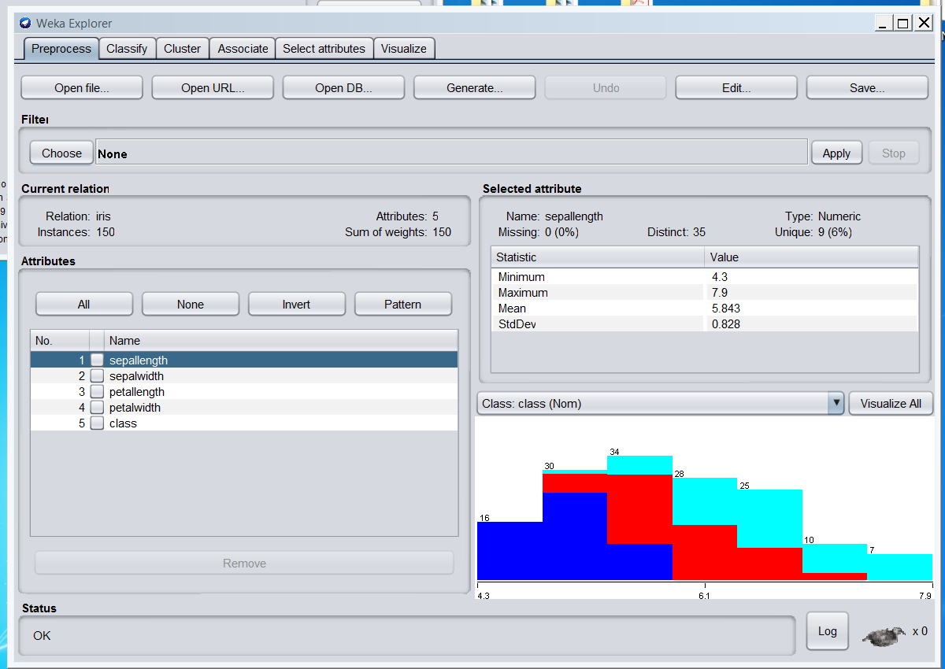
Clicking on this will bring up a list of all of the filters, organized into a hierarchy. Click on each folder to expand the list. There are dozens of choices

Slide 22
Discretization
Discretization: numerical feature → categorical
In preprocess tab select “Choose”, expand “unsupervised” then “attribute”
Select “Discretize” filter
Note discretize applies to attributes not instances
The following few slides are from an earlier version and may look just a little bit different
Note: there is a version under the “supervised” folder but it works differently and has different options

Slide 23
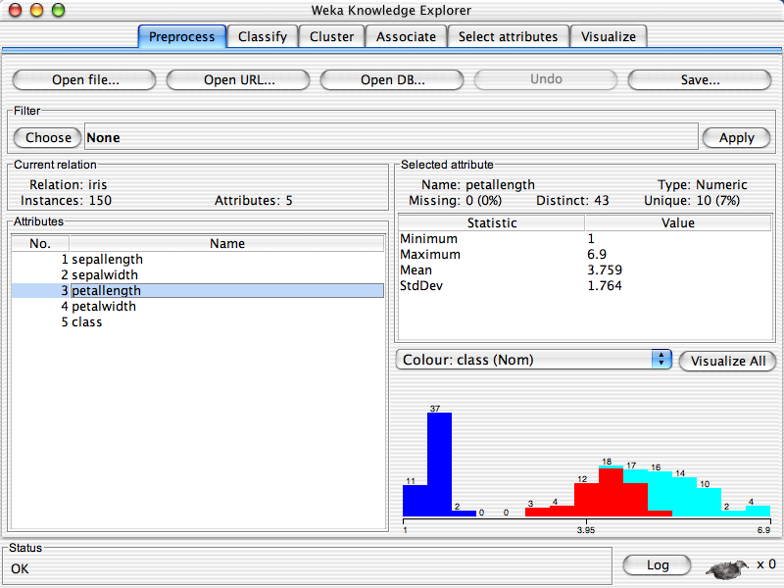

Slide 24
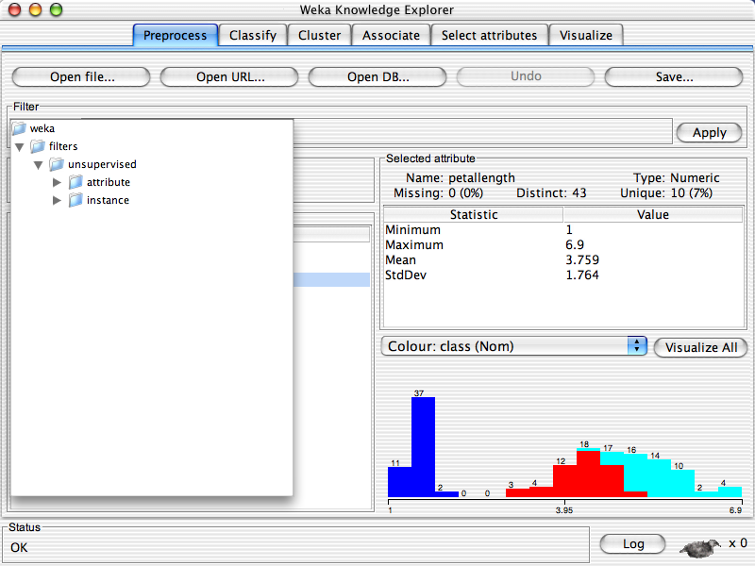

Slide 25
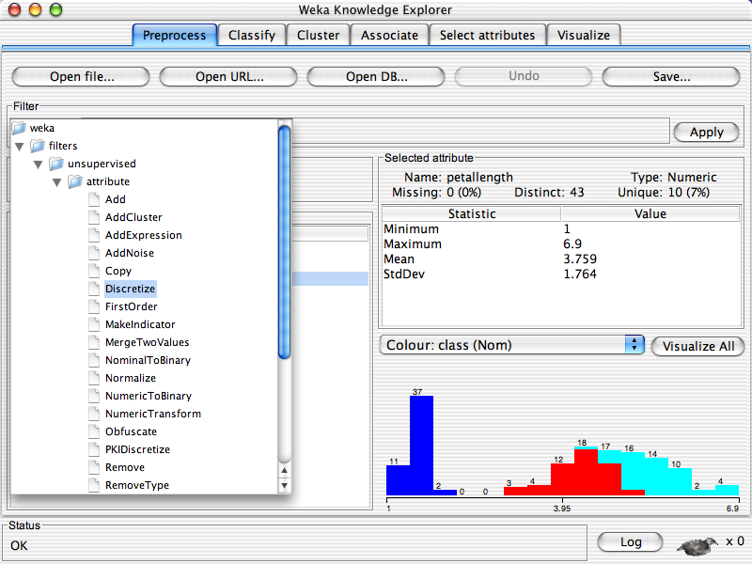

Slide 26
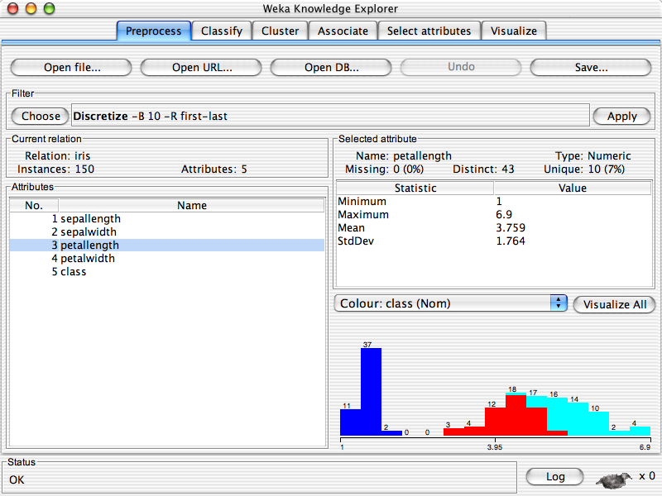
This shows the command line with options. Click within this region to bring up a window with the options and more info

Slide 27
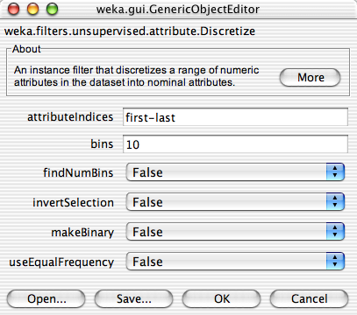
Create 10 equal frequency bins
Will do for all numerical features given “attributeIndices” value
Click for documentation
1) Toggle to “True”
2) Click OK

Slide 28


Slide 29
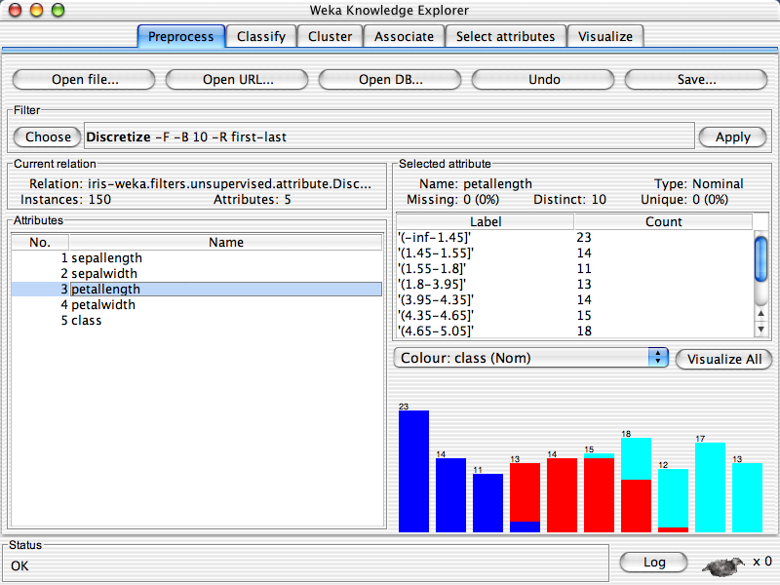
Can use undo to undo the last command
Note there are 10 bins
Frequencies not equal but as close as possible

